Slide 1
Holmes Road Elementary School Open House August 26 @ 4:30 p.m. Annual Title I Meeting 5:00-6:00 p.m.
Shannon Banks-Cotton, Principal
Alicia Saulsberry, Assistant Principal
Allison Duncan, Assistant Principal
Lashonda Mcneal, PLC Coach
KIERRA PRATT, INSTRUCTIONAL FACILITATOR
Trina O'Banner, Professional School Counselor

Slide 2
Shannon Cotton, Principal

Slide 3
Meeting Norms
Be respectful
Listen actively
Actively participate

Slide 4
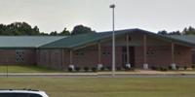
About Us
School Hours
9:15 a.m.-4:15 p.m.
Breakfast starts at 8:45 a.m.
NO BREAKFAST SERVED AFTER 9:15 a.m.
1083 Holmes Rd.
Memphis, TN 38116
Phone: 901-416-6469
Fax: 901-416-2469

Slide 5
Holmes Road Elementary School’s
The Mission of Holmes Road Elementary is to build leaders with the academic skills to be competitive, self-managed, socially aware, life-long learners.

Slide 6
The Vision of Holmes Road Elementary is the facilitation of the building of student foundational skills, planning and obtaining goals and persevering through challenges, in a student centered environment.
Holmes Road Elementary School’s

Slide 7
Pre-K
Joy and Thomas
Foster and Bolton
Scott and Woodard
Terry and Whitaker
FS Academic Support Staff
S. Campbell
S. Johnson
M. Latin
T. Thomas
T. Williams
Bowser
K. Jackson
T. Brown
T. Williams
Appleberry
WHO’S WHO AT HOLMES ROAD?
Kindergarten
Richardson
Thurman
McGee
Summerford
Cartwright
1st Grade
Rubin
C. Harris
Speaks
Harper
Smith
2nd Grade
Barnes
Pollion
Garrison
Farmer
Summerville
3rd Grade
Walker
Sanders
Neal
Atieh
Todd
4th Grade
Whatley
Phillips
Anderson
Brown
5th Grade
Dyer
N. Harris
Vester
Gunn
House

Slide 8
Office Staff
Downey-Smith (Financial Secretary)
C. Williams
(Secretary)
Steward
(Wells)
Jimmerson
(Attendance Specialist)
Behavior Support
O'Banner
(Counselor)
Mr. Hunter ( Behavior Specialist)
L. Davis (Family Engagement Specialist)
Support Team
A. Williams(P. E) King (Music) Houston(ISS/Computer 1) T. Hunter (RTI2) (CLUE) Ms. Payne(Speech) | Brock (P.E.) Wynn (Library) Langston (Computer 2) S. Mitchell (Art) Phillips-Dixon (Art) Dr. Randle (ESL)
WHO’S WHO AT HOLMES ROAD?
Teacher Assistants
Ms. Hines
Ms. Tate
Ms. Stephens
Mr. Rodgers
Mr. Tubbs
Ms.N. Brock
Ms. T. Brown
Cafeteria
Williams
J. Mitchell
McKinley
Taylor
Ferrell
Martin
Dooley
Custodial Staff
Mr. Harris- Building Engineer
-Parcou-

Slide 9
Holmes Road School Level TCAP Composite Scores and TVAAS Data

Slide 10
How will we address our deficits?
RTI2
HRES Cub Academy (S.W.A.G.)
Before School Tutoring (Starts September 6)
ZAP Fridays (Zeros are not permitted!)
4th Grade In-School Tutoring
Blended Learning
Morning Skills Drill from 9:15 to 9:30

Slide 11
Annual Title 1 Overview L. Nicole Mcneal, PLC Coach

Slide 12
District/School Progress/AYP
Under new federal measures for accountability, each school is responsible for a portion of the school district’s AYP AMOs. Students in this subgroup scored in the bottom five percent in the state of Tennessee. The school will also provide additional support, such as beginning tutoring earlier in the school year, and strengthening the School-Wide Intervention Block. Students will use Reading/Math IXL to review missed standards.
School Improvement Plan
Holmes Road Elementary School maintains a current School Improvement Plan which is updated annually to reflect current data and changing student needs. We solicit your support in bringing ideas for increasing student achievement. A copy of the plan will be made available upon your request in October.

Slide 13
Annual Title 1 Overview Lashonda Mcneal, PLC Coach
Additional Parent Meetings
Annual Title I Parent Meetings
Parent Trainings (TBA)
Curriculum Night(s)
Parents’ Right to Know
All parents have the right to request the following:
A teacher’s professional qualifications, licensure, grade(s) certification, waivers
A teacher’s baccalaureate and/or graduate degree, fields of endorsement, previous teaching experience
A paraprofessional’s qualifications
An annual notice of Student Education Records Privacy and notice for disclosure of School Directory Information
An assurance that their child’s name, address and telephone listing not be released to military recruiters
All parents should receive the following:
Their child’s level of achievement on each of the state’s academic assessments
Notification of right to transfer their child to another school in the district if the student becomes the victim of a violent crime or is assigned to an unsafe school
District Family Involvement Policy and School Parent Involvement Policy
Their right to public school choice, Supplemental Educational Services and more effective involvement if their child’s school is identified for school improvement

Slide 14
Annual Title 1 Overview Lashonda Mcneal, PLC Coach
Teacher Qualifications
All teachers hold a state-issued teaching certificate or permit. We currently have a Certified Sub in one of our 3rd Grade math classes and our Pre-K Sped class.
Title I School Status
Holmes Road Elementary operates a School-wide Title I program.
School/Parent Compact
Federal law requires us to distribute our School/Parent Compact to parents to ensure their involvement in their children’s educational process. This document is located on the school’s website and distributed with the next textbook pick-up.
Family Engagement
SCS Policy 7009
Federal law

Slide 15
Annual Title 1 Overview Lashonda Mcneal, PLC Coach
Family Engagement
SCS Policy 7009
Federal law requires us to distribute our Family Engagement Plan to parents to ensure their involvement in their children’s educational process. This document will be distributed during the next book pick-up It is also located on the school’s website.
Reporting of Pupil Progress
Pupil progress is reported through Progress Reports and Report Cards. IXL reports, I-Ready Diagnostic reports, Performance Matters, Illuminate reports for intervention, and classroom teacher contact (via phone, print, or email) will be used as reporting resources as well.

Slide 16
Annual Title 1 Overview Lashonda Mcneal, PLC Coach
Parent-Teacher Conferences
District-wide Parent-Teacher Conferences are held twice a year (one per semester). Additionally, parents may request a parent-teacher conference by appointment at any time throughout the school year. Our next Parent Conference will be Thursday, September 5, 202, from 4:00 p.m. until 7:00 p.m. Tonight's meeting is for the teachers to give you information concerning various classroom topics. Contact your child’s teacher if you would like a conference.
Parental Involvement Requirements
Please see Family Engagement and School/Parent Compact.
See the PLC Coach or Family Engagement Specialist.
Ms. Lizzie Davis, Holmes Road Elementary Family Engagement Specialist

Slide 17
Annual Title 1 Overview Lashonda Mcneal, PLC Coach
Parent Training
Family and Community Engagement (FACE)
COE Building, Room 164 160 South Hollywood, Memphis, TN 38112 901-416-7600
FACE offers a variety of parent trainings and assemblies.
To receive a calendar of these events, please call the FACE Office .
MSCS Parent Welcome Center
2687 Avery Ave.
Memphis, TN 38112
901-416-5300

Slide 18
Student Code of Conduct Alicia Saulsberry, Assistant Principal Allison Duncan, Assistant Principal
Student Code of Conduct
The SCS Student Code of conduct will be distributed. To receive additional copies, please visit the Shelby County Schools’ website – www.scsk12.org – under the Students & Parents tab.
HRES Student Handbook
Students were given a copy of the HRES Student Handbook today. Please sign the back page and return by Friday, 9/6/24.
Please call 901-416-6469 if you did not receive your child's Handbook.

Slide 19
SOCIAL MEDIA TRENDS THAT ARE ZERO TOLERANCE

Slide 20
Notes:
Ms. Milow and Ms. Chatman will add the bullets to this slide.

Slide 21
Attendance Adds up to a great Loss

Slide 22
Attendance Mrs. McNeal and Ms. O'Banner, Professional School Counselors Ms. Davis, Family Engagement Specialist Ms. Jimmerson, Attendance Specialist
How many days can a student miss school in TN?
A Tennessee student is considered truant at five unexcused absences and may be subject to legal intervention. Chronic Absenteeism: Missing school for any reason (excused, unexcused, suspended/expelled).
How many excused absences are allowed in Tennessee?
Students are allowed 10 days of excused absences before they become truant. Students are allowed 5 days of unexcused absences before they become truant.
By Law all students are expected to attend school everyday that school is officially in session and remain at school for the entirety of the school day. Only the following reasons will be considered for excused absences.
The Shelby County Board of Education believes that regular attendance is a necessary requirement of all students and that any student with the maturity and interest should be included in some phase of the school program.
All students are expected to attend school on each day that school is officially in session. Only the following reasons will be considered for excused absences:
Illness or hospitalization of student. Physician verification will be required to justify absences after the accumulation of ten (10) days of absence during a school year. Notes must be date specific and will be required for subsequent absences beyond ten (10) days.
Death or serious illness within the student's immediate family.
When the student is officially representing the school in a school sponsored activity.
Special and recognized religious holidays regularly observed by persons of their faith.
Legal court summons not as a result of the student's misconduct.
Extenuating circumstances over which the student has no control as approved by the principal.
How many days absent is 97%?
Attendance
% PERCENTAGE | Days absent
97 | 5 days out
96 | 7 days out
95 | 9 days out
ALL STUDENTS ARE REQUIRED TO BE PRESENT 97% OF THE TIME

Slide 23
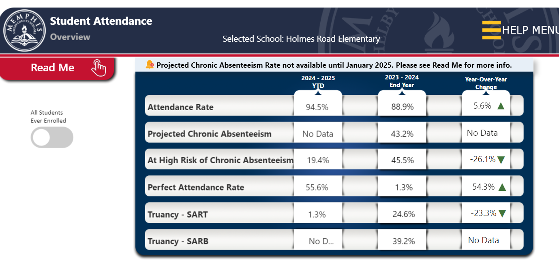
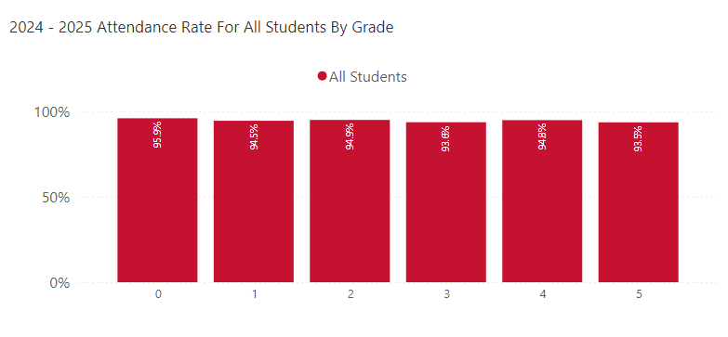
Current Attendance

Slide 24
Today is Monday, August 26, 2024. School has been in session for 16 days and we already have a 19.4% CHRONIC ABSENTEEISM RATE

Slide 25
Third Grade Commitment

Slide 27
Response to Intervention and Instruction (RTI2) Tracy Hunter, RTI2 Lead & Interventionist
Notes:
Mrs. Hunter will add her agenda here about RTI-2. It is not an IEP etc…

Slide 29
Regularly check the SCS website for updates.
http://www.scsk12.org/

Slide 30
Thank you for your Attendance. Please Click on the QR Code to complete the form so we can better assist you.

Slide 31
Open House
You will now go to your child’s grade level classroom for specific information.
Parent Conferences will be held September 5th from 4 p.m. -7 p.m.

Slide 32
Thank you for attending!

